Slide 1
Kidney Exchange
INFO 4220 – Networks II: Market Design
Adapted from Haeringer Ch.16

Slide 2
Kidney Transplantation
Kidney transplantation is necessary for end-stage renal disease.
  There is a big shortage of transplantable kidneys
In January 2016 there were a bit over 100,000 people waiting for a kidney transplant in the U.S.
Each year:
  Nearly 4,000 patients become too sick to receive a transplant
  Almost 5,000 patients die waiting for a kidney
Without a kidney transplant, patients must stay in dialysis

Slide 3
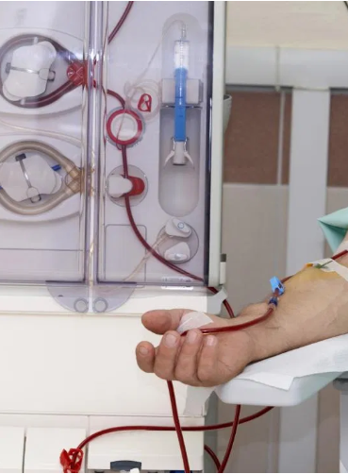
Dialysis
Dialysis is burdensome and expensive (~80k/year)
Process in which blood is filtered by external machine
As kidney deteriorates, it is needed more frequently

Slide 4
How to Get a Kidney
There are two possibilities to get a kidney:
From a deceased donor:
  Managed through a waiting list that takes into account:
    Waiting time
    State of the patient
    Other factors (e.g. location, availability of the patient, etc.)
From a living donor:
  The human body has 2 kidneys, but (for most people) we only need one to survive
  A loved one, or an altruistic individual, could give a kidney to a patient

Slide 5
Transplants in the U.S.
In 2016, there were 17,878 kidney transplants in the U.S.
  13,431 from deceased donors
  5,640 from living donors
Allocating a donation from a deceased patient is simple. Once a kidney becomes available, it is allocated to the compatible patient with the highest priority in the waiting list
Living donors are more complicated: Often a relative wants to donate a kidney to a specific person, but they are not always compatible

Slide 6
Institutional Constraint:
No Money
National Organ Transplant Act (1984) makes paying for an organ for transplantation a felony:
  “it shall be unlawful for any person to knowingly acquire, receive or otherwise transfer any human organ for valuable consideration for use in human transplantation”
The 1984 NOTA also established the Organ Procurement and Transplantation Network
  US Congress views deceased kidneys offered for transplantation as a national resource
United Network for Organ Sharing (UNOS) oversees the allocation of deceased donor kidneys
Living donations were a lot less organized until 2004

Slide 7
Kidney Compatibility
Tissue type compatibility:
  Cells have markers that the immune system uses to detect foreign objects
    The body rejects what it doesn’t recognize as part of it
  If tissue is similar “enough” this can be controlled using immunosuppressants
Blood type compatibility:
  Blood comes in different types. It depends on some proteins that we have (or not) in our red cells
  Cannot be bypassed

Slide 8
Blood Types
There are 4 blood types: A, B, AB, and O. They correspond to proteins in red cells:
  A type blood: Red cells have marker A
    (40% in the US)
  B type blood: Red cells have marker B
    (11% in the US)
  AB type blood: Red cells have marker A and B
    (4% in the US)
  O type blood: Red cells DO NOT have markers A or B
    (45% in the US)
Your blood type determines the type of blood (and tissue) you can receive

Slide 9
Blood Types
O
A
B
AB
O can only receive from O (but can give to anyone)
A can receive from O and A (and give to A and AB)
B can receive from O and B (and give to B and AB)
AB can receive from anyone (but only give to AB)

Slide 10
Live Donors Transplants: Paired Kidney Exchange
Traditionally: A patient finds a willing donor. If they are compatible, the transplant takes place
Paired exchanges first proposed in 1986 (Rapaport)
First kidney exchange was done in South Korea in 1991 by Dr. Kiil Park
In the US, in 2000, the transplantation community issued a consensus statement declaring Paired Exchanges “ethically acceptable”
  Urged all four operations to be done simultaneously
First kidney paired exchange in U.S. in 2000 (in R.I.)
  Very rare before formal exchanges were organized. Only 5 paired exchanges in New England between 2000-2004

Slide 11


Paired Kidney Exchange
OK!
Joe wants to give a kidney to his mom, but they are not compatible
Joe is compatible with Jane’s mom
Hey Joe, I will give a kidney to your mom if you give a kidney to my mom
Joe
Joe’s Mom
Jane is compatible with Joe’s mom
Jane wants to give a kidney to her mom, but they are not compatible
Jane
Jane’s Mom

Slide 12
Notice this looks like the Housing Allocation Problem w/ Endowments
Think of the donor’s kidney as the endowment of the intended recipient
Think of the preference list as a list of the most compatible kidneys
Joe (donor)
Joe’s Mom (Patient)
Jane’s Mom (patient)
Jane (Donor)

Slide 13
There Could be Long Chains Too
Joe (donor) Joe’s Mom
Jane (donor) Jane’s Mom
Jack’s Mom Jack (Donor)
Jon’s Mom Jon (Donor)
Without a centralized market it was already hard to organize pair-wise exchanges
Longer exchanges only possible with a centralized market

Slide 14

How Long Could Chains Be?
The longest kidney donation chain facilitiated 35 transplants:
  70 surgeries
  25 transplant centers
  Started on January 6, 2015, and ended on March 26, 2015
  Enabled by Kathy Hart, a Good Samaritan donor that gifted a kidney to a stranger at the University of Minnesota Medical Center
Typical chains are much shorter, at most 3-4 pairs on average
https://www.kidneyregistry.com/news/guinness-world-record-organization-distinguishes-the-national-kidney-registry-for-worlds-longest-kidney-transplant-chain/

Slide 15
What if a patient has a donor, but they are not compatible, and a pair exchange is not possible?

Slide 16
List Exchanges
Suppose that Joe wants to give a kidney to his mom, but they are not compatible, and a pair-wise exchange is not feasible:
  Can we give Joe’s kidney to somebody else and “compensate” Joe for giving her donor’s kidney to someone else?
A list exchange is a form of indirect exchange:
  Treat the kidney as a deceased kidney: Give it to the highest priority compatible patient in the waiting list
  Give the patient a high priority position in the waiting list
  Notice this sounds a bit like YRMH-IGYT: You request my kidney, I get your position in the waiting list (it is more complicated than this, but I will remind you of this later)

Slide 17
Problems of List Exchanges
List exchanges are harmful for type O patients
  Such patients can only receive a type O kidney
  Very few type O kidneys will be offered by a living donor
Why?
  Recall the case where Joe wants to give a kidney to her mom. If he is type O, he can donate to anyone
  Thus, they will not need to enter the list exchange
  Any living donor offering a type O kidney to the list will be an altruistic donor (there are not that many of them)
    O blood type: Universal donor, but can only receive from O types
    AB blood type: Universal Recipient, but can only donate to AB

Slide 18
Designing Kidney Exchanges
We need to combine in the same mechanism
  Trades (Paired exchanges)
  Waiting list (List exchanges)
It looks like a problem of assigning objects (kidneys) with mixed endowments where:
  Private endowments: Donor’s kidneys are “privately held” by the patients that can participate in trades
  The problem is we don’t have a parallel to public endowments. Kidneys from cadaveric patients are not a public endowment (unassigned). They are for the list. They are also not available, they become available randomly.
  Patients either: Obtain a kidney from living donor, or join (remain in the waiting list)

Slide 19
Designing Kidney Exchanges
Thus, we need to design an exchange mechanism that combines at the same time:
  Trades between donors and patients
  The management of the waiting list for cadaveric donors

Slide 20
The Kidney Exchange Algorithm
Let’s first describe the model:
We have a set of patients:
  Some come with a donor
  Some come alone
There is a set of kidneys (proposed by the living donors)
Each patient has a (strict) preference relation over kidneys and the option of joining the waiting list:
  Preference is related to compatibility with the kidney
  A kidney is acceptable if it is compatible. Otherwise, it is unacceptable

Slide 21



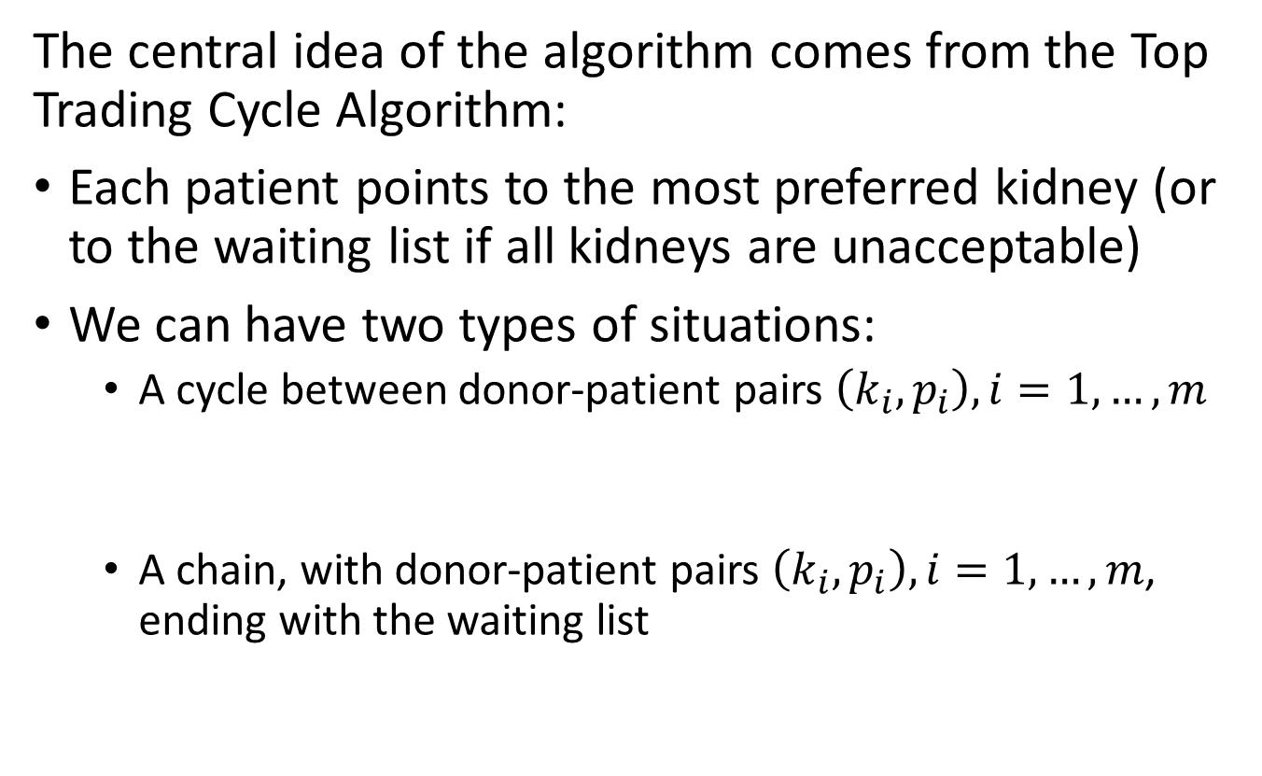





The Kidney Exchange Algorithm
The central idea of the algorithm comes from the Top Trading Cycle Algorithm:
Each patient points to the most preferred kidney (or to the waiting list if all kidneys are unacceptable)
We can have two types of situations:
  A cycle between donor-patient pairs $\left(k_{i},p_{i}\right),i=1,…,m$
  A chain, with donor-patient pairs $\left(k_{i},p_{i}\right),i=1,…,m$, ending with the waiting list
$$k_{1} p_{1}$$
$$k_{2} p_{2}$$
$$k_{3} p_{3}$$
. . .
$$k_{m} p_{m}$$
$$k_{1} p_{1}$$
$$k_{2} p_{2}$$
$$k_{3} p_{3}$$
. . .
$$k_{m} p_{m}$$
W

Slide 22
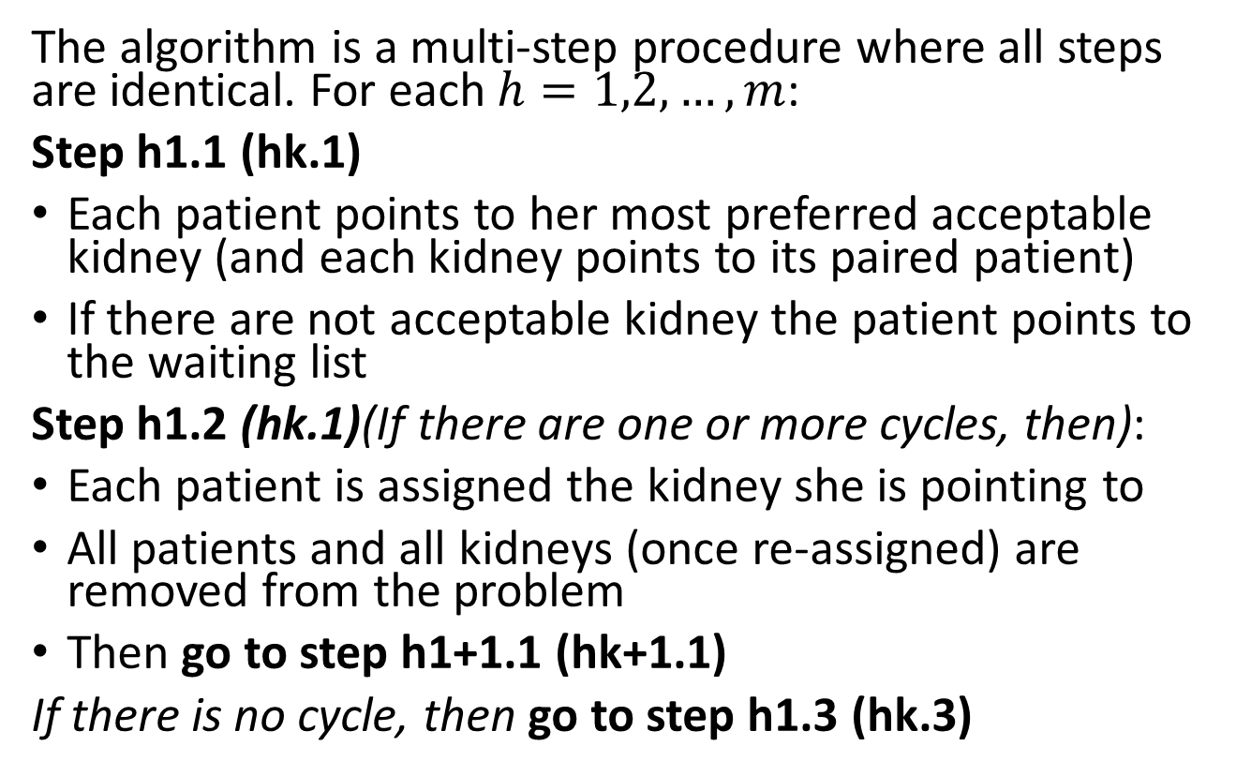
Top Trading Cycles and Chains
The algorithm is a multi-step procedure where all steps are identical. For each $h=1,2,…,m$:
Step h1.1 (hk.1)
Each patient points to her most preferred acceptable kidney (and each kidney points to its paired patient)
If there are not acceptable kidney the patient points to the waiting list
Step h1.2 (hk.1)(If there are one or more cycles, then):
Each patient is assigned the kidney she is pointing to
All patients and all kidneys (once re-assigned) are removed from the problem
Then go to step h1+1.1 (hk+1.1)
If there is no cycle, then go to step h1.3 (hk.3)

Slide 23
Top Trading Cycles and Chains
Step h1.3 (hk.3)
Select one chain and allocate kidneys in the following way:
The last patient in the chain is added to the waiting list
The other patients in the chain (if any) are assigned the kidney the are pointing to
For all patients involved in the selected chain, the assignment is final
A chain selection rule determines whether the selected chain is removed from the problem
Go to step h1+1.1 (hk+1.1)
END: All patients have been assigned to a kidney or added to the waiting list

Slide 24
Roth, Sönmez, Unver 2005
Proposition: For a finite number of patients and kidneys there must always exist a cycle or a chain
At each step (cycle or chain) the number of remaining patients decreases. So, the algorithm eventually stops
The algorithm describes a family of algorithms: It depends on the chain selection rule we use
In September 2004, the Renal Oversight Committee of New England approved creating of a clearinghouse for kidney exchanges

Slide 25
Chain Selection Rules
The Top Trading Cycle and Chains algorithms is vague w.r.t. how we should select the chain (when there is no cycle)
There are two main issues:
With chains, unlike cycles, an individual or kidney can be part of different chains
When patients and kidneys are involved in a chain, should we remove them from the problem? Or leave them in the problem so they can become part of a future cycle or a longer chain?

Slide 26
Issue #1: Patients or Kidneys in multiple chains
Suppose we have 3 patient-donor pairs:
  (Alice, Albert) ; (Beth, Bob) ; (Carol, Calvin)
The preferences over donor’s kidneys are:
  Alice: None of the available kidneys are acceptable to her, so she points to the waiting list
  Beth: She prefers Albert’s kidneys to the waiting list (and Calvin’s kidney is unacceptable)
  Carol: She prefers Albert’s kidneys to the waiting list (and Bob’s kidney is unacceptable)

Slide 27
Issue #1: Patients or Kidneys in multiple chains
Calvin Carol
Albert Alice
W
Bob Beth
What do we do in this case?
In this case, we need a chain selection rule that chooses only one of the two possible chains

Slide 28
Issue #2: Should we remove patients/kidneys involved in a chain?
Suppose we have 3 patient-donor pairs:
  (Alice, Albert) ; (Beth, Bob) ; (Carol, Calvin)
The preferences over donor’s kidneys are:
  Alice: None of the available kidneys are acceptable to her, so she points to the waiting list
  Beth: She prefers Albert’s kidneys to the waiting list (and Calvin’s kidney is unacceptable)
  Carol: She prefers Albert’s kidneys to Bob’s Kidney, and Bob’s Kidney to the waiting list

Slide 29
Issue #2: Should we removed patients/kidneys involved in a chain?
First step is same as before:
Calvin Carol
Albert Alice
W
Bob Beth
Now, let’s assume that the chain selection mechanism chooses the chain: Bob, Beth, Albert, Alice, W.
  Algorithm says: Alice joins waiting list, Beth gets Albert’s kidney
  Doesn’t say what to do with Bob’s kidney? Goes to somebody in the waiting list? Does it remain unassigned?

Slide 30
Issue #2: Should we removed patients/kidneys involved in a chain?
What we do with Bob’s kidney matters:
  If it goes to the waiting list, someone in the list gets a kidney, but Carol doesn’t
  If it remains in the problem unassigned, with the new preferences we would have:
Calvin Carol
Albert Alice
W
Bob Beth

Slide 31
Quiz/PollEV
Suppose we have 3 patient-donor pairs (Alice, Albert); (Beth, Bob); (Carol, Calvin). People in the pairs are not compatible
Alice prefers Bob’s kidney. No others are acceptable
Carol prefers Bob’s kidney over Albert’s, but prefers Albert’s over the waiting list
Beth prefers Albert’s kidney over Calvin’s, but prefers Calvin’s kidney over the waiting list. Using the TTC and chains algorithm to find matches. How will the match look like:
A) Alice-Bob, Beth-Albert, Carol joins the waiting list (What happens to Calvin’s kidney determined by the chain selection rule)
B) Alice-Bob, Carol-Albert, Beth-Calvin

Slide 32
Possible Selection Rules
(Roth, Sönmez, Ünver)
Choose the smallest chain, and remove from the problem the patients and kidneys in those chains once the assignment is determined
Choose the longest chain, and remove from the problem the patients and kidneys in that chain (pick one at random if it is not unique)
Choose the longest chain, and keep in the problem the patients and kidneys in that chain (pick one at random if it is not unique)

Slide 33
Possible Selection Rules
(Roth, Sönmez, Ünver)
Choose the chain that starts with the highest-priority patient, and remove from the problem the patients and kidneys in that chain
Choose the chain that starts with the highest-priority patient, and keep in the problem the patients and kidneys in that chain

Slide 34
Possible Selection Rules
(Roth, Sönmez, Ünver)
Prioritize patient-donor pairs so that pairs with a type O donor have a higher priority (than the pairs w/o type O donor). Then choose the chain that starts with the highest-priority pair. If the starting pair in the chain has the type O donor, then remove from the problem the patients and kidneys in that chain. Otherwise, keep in the problem all the patients and donors that are in that pair

Slide 35
Efficiency
A kidney exchange mechanism is efficient if, for any problem (set of patients, donors, and their preferences) it always selects an assignment such that:
There does not exist another assignment that is weakly preferred by all patients (and strictly preferred by at least one patient)
Theorem:
Consider a chain selection rule such that any chain selected at a non-terminal step remains in the procedure*. Then, the TTC and Chains mechanism, implemented with such chain selection rule, is efficient
* This means the kidney of the first donor remains available for trade in the next steps

Slide 36
Incentives
Do patients have an incentive to report truthfully their preferences?
Theorem:
An assignment mechanism that uses the Top Trading Cycle and Chains algorithm with the chain selection rules a, d, e, or f is strategyproof
Note: Rules e and f are particularly appealing.
Rule e is both efficient and strategyproof. In fact, it is equivalent to the YRMH-IGYT algorithm
Rule f is not efficient, but has the advantage of increasing the inflow of type O kidneys

Slide 37
Number of Exchanges (length of cycles)
In theory, the top trading cycle and chains algorithms is a good way to increase the number of transplants
However, implementing it in real life is not possible. Cycles may involve many pairs of patient-donor pairs
To prevent donors from walking away once their patient is transplanted, exchanges require simultaneous surgeries for:
  Procuring of donors’ kidneys
  Transplantation of the kidneys

Slide 38
Number of Exchanges (length of cycles)
In practice, it is practical to consider two-way or three-way exchanges (i.e. 2 or 3 pairs)
How many opportunities are forgone with this limitation?
  In a standard assignment this question would be impossible
  In kidney exchanges preferences are determined by blood types, so there is a strong structure on the preferences
  Roth, Sönmez, Ünver show that if there is no restriction on the length of cycles then the maximum length of a cycle is equal to the number of blood types

Slide 39
Number of Exchanges (length of cycles)
We also need to consider that the distribution of blood types also plays a role. Pairs (patient-donor) O-A, O-B, or O-AB are more frequent that pairs A-O, B-O or AB-O.
They run numerical simulations that suggest that after 3-way exchanges there aren’t many gains (table for each number of pairs in the population, the number of matches achieved)
# Pairs | 2-way | Up to 3-way | Up to 4-way | unrestricted
25 | 8.0 | 11.3 | 11.8 | 12.0
50 | 21.8 | 27.3 | 28.0 | 28.1
100 | 49.7 | 59.7 | 60.4 | 60.4

Slide 40
Kidney Exchange
Kidney Exchanges are probably the most famous applications of market design
Before 2004, there were a few cases where surgeons were able to arrange an exchange of donor kidneys
  Only 5 at the 14 transplant centers in New England
Research by Roth, Sönmez and Unver (2004) showed how the top trading cycle algorithm could be adapted to organize kidney exchanges
Idea was quickly picked up by the medical community and several US regions established centralized kidney exchanges

Slide 41
Take Away
Kidney transplantation is the best treatment for end-stage renal disease. Kidneys are scarce
Most living donors want to donate to a specific person, but they may not be compatible
Buying/selling organs is repulsive (for most people), but using an exchange (w/o money) is acceptable (to most people)
An assignment mechanism can be used to redistribute kidneys (from living patients) to patients

Slide 42
Take Away
Kidney exchange problem has some differences with typical assignments problems:
  Patients that have a living donor have a private endowment
  There are also deceased donors whose organs are not public endowment (because they are not available yet). We replace them with a waiting list
Top Trading Cycle and Chains (TTCC) algorithm manages simultaneously:
  The exchange of kidneys from living donors
  The waiting lists for kidneys from deceased donors

Slide 43
Take Away
The TTCC actually defines a family of algorithms. There are multiple variations based on the chain rule selection we used. Chain rule defines:
  Which chain is selected
  Whether the chain is removed once selected
Some chain selection mechanism create an algorithm that is efficient. Some also guarantee strategyproofness
Kidney exchanges require to coordinate simultaneous surgeries, which makes long cycles unfeasible:
  But this isn’t much of a problem, because kidney compatibility is determined by limited # of blood types. With 3-way exchanges most matches can be achieved.

